Slide 1
A New Process for Submitting Single IRB Exception Applications:
Effective May 1, 2021
Don E. Workman, PhD, VA IRB Network Director
Karen Jeans, PhD, Director, ORPP&E Regulatory Affairs
Dial in (Main): (404) 397-1596
Attendee Access Code: 199 - 577- 0144
Slides available on SharePoint:
See link in Q&A Box

Slide 2
Topics
  Review of the Regulatory Issues/requirement
  Process available to VA for evaluating exceptions for use of a single IRB
    Current process: emailing applications
    New Process: Using SharePoint application, effective May 1, 2021

Slide 3
2018 Requirements: Cooperative Research Provision (Single IRB)
January 20, 2020 was the compliance date of the cooperative research provisions in 38 CFR§16.114 of the 2018 Requirements.
VA Non-Exempt Human Subjects Research approved or transitioned to follow the 2018 Requirements of the Common Rule is required to use a single IRB:
  if more than one institution is engaged in the research and any of the following applies to the multi-site research:
    The cooperative non-exempt human subjects research is funded or supported by any of the federal agencies or departments who agreed to apply the 2018 Requirements, or.\
    Any of the other engaged institutions are federal agencies or departments who agreed to follow the 2018 Requirements, including other VA Facilities.
However, some cooperative research is not required to use the single IRB requirement.

Slide 4
Cooperative Research Not Subject to Use of a Single IRB
(i) Cooperative research for which more than single IRB review is required by law (including tribal law passed by the official governing body of an American Indian or Alaska Native tribe); or
(ii) Research for which any Federal department or agency supporting or conducting the research determines and documents that the use of a single IRB is not appropriate for the particular context.
38§16.114 (b)(2)

Slide 5
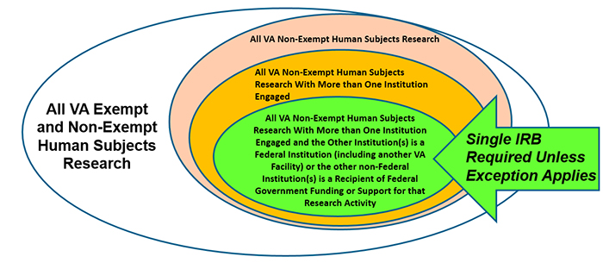
Single IRB Implementation in the VA
Single IRB Implementation in VAs

Slide 6
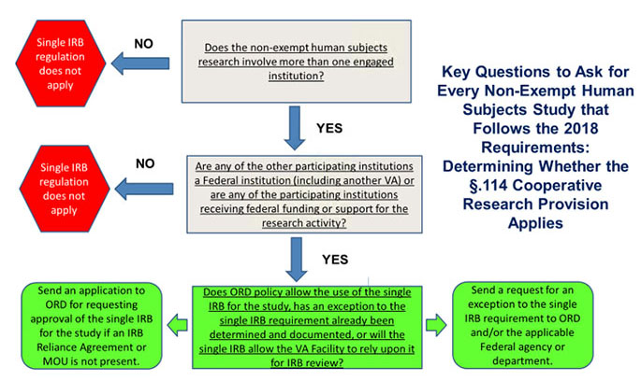
Determining Whether the §.114 Cooperative Research Provision Applies
NEW PROCESS For Applying to Exception from Single IRB Requirement!

Slide 7
Requesting an Exception from the Single IRB Requirement for Cooperative Non-Exempt Human Subjects Studies
ORD supports use of a single IRB when possible, but ORD also recognizes that mandating use of a single IRB in all cases is not logical or feasible. The §.114 cooperative research provision also recognizes that use of a single IRB is not always required.
ORD has the authority to grant exceptions from the use of a single IRB for VA Facilities participating in research subject to the cooperative research provisions.
  The other Common Rule agencies recognize the exceptions granted by VA to the cooperative research provisions.
  VA recognizes exceptions granted by other Common Rule agencies.

Slide 8
Who can Submit a Request for a Single IRB Exception?
The single IRB exception request form must be completed by any of the following:
ORD funding service,
ACOS/R&D,
AO/R&D,
VA Human Research Protections Administrator, or
VA Facility’s IRB Administrator.
VA Principal Investigators are not permitted to submit a request for exceptions.

Slide 9

Requesting an Exception for Use of a Single IRB: Stopping Use of Email Requests
VHA Facilities wishing to request an exception from the single requirement for an applicable study must
  Submit a request to the IRB Reliance and SIRB Exceptions email box at (IRBRelianceandSIRBExceptions@va.gov) using the spreadsheet: Prospective CHNE Research Exceptions Request. The request must be sent to ORD by the ORD funding service, ACOS/R&D, AO/R&D, VA Human Research Protections Administrator, or the VA Facility’s IRB Administrator.
  The email subject line should reference that it is a request for single IRB exception with the name of the study and the VA Principal Investigator.

Slide 10
New SharePoint Application Process
Only users with a va.gov email address can access the SharePoint site.
https://dvagov.sharepoint.com/sites/VHAORPPE/IRBRelianceRequests/Home/SitePages/Exemption%20Requests.aspxequests

Slide 11
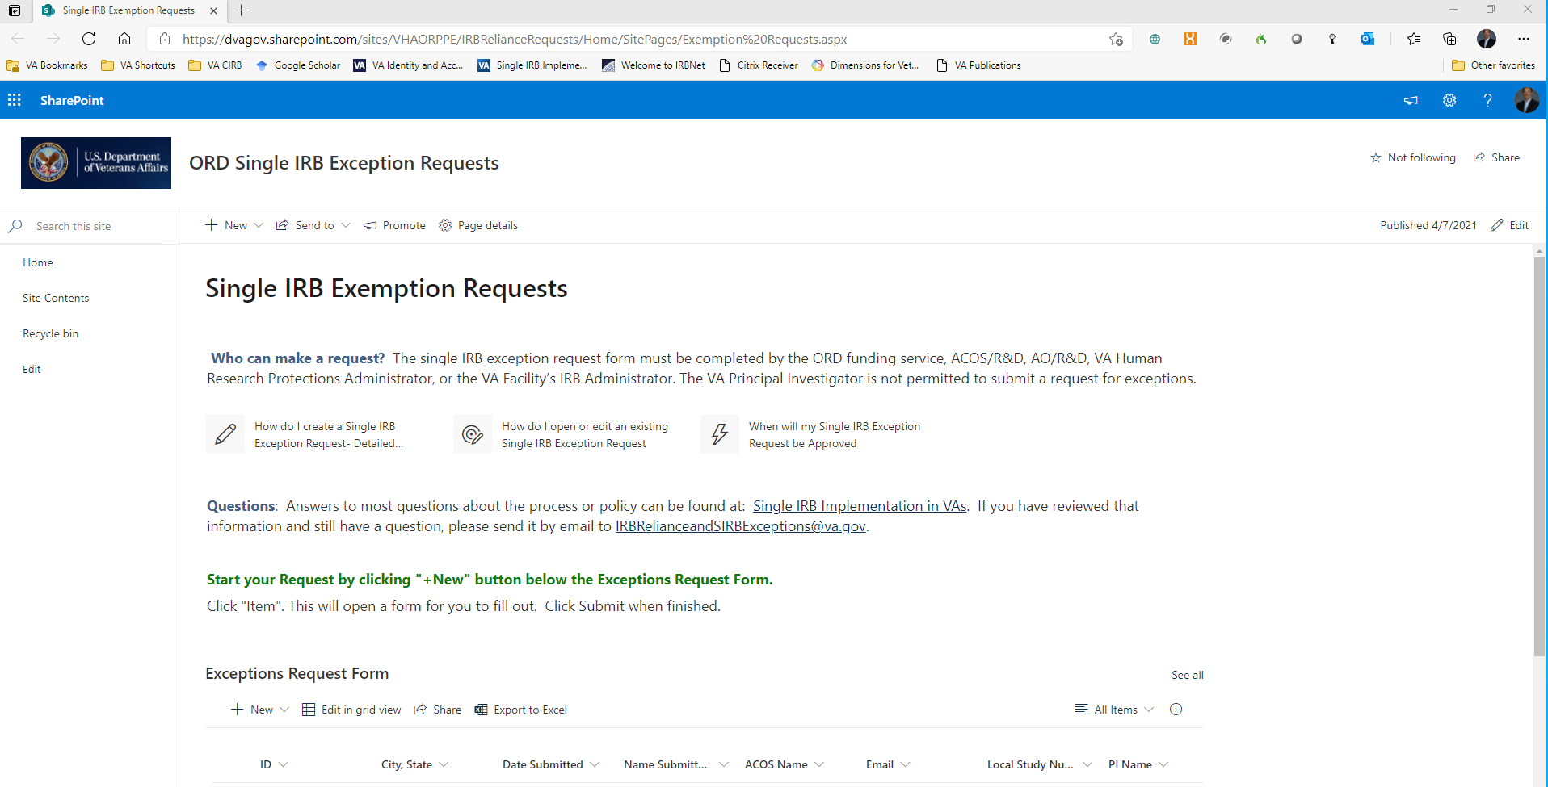
New SharePoint Application Process For Requesting Single IRB Exceptions

Slide 12
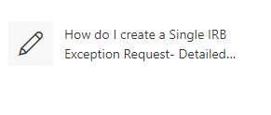
New SharePoint Application Process

Slide 13
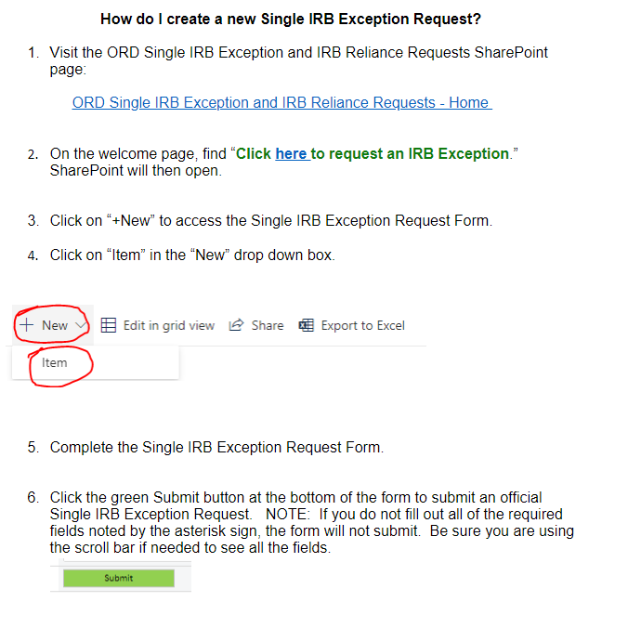

Slide 14
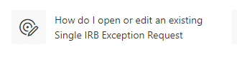
New SharePoint Application Process

Slide 15
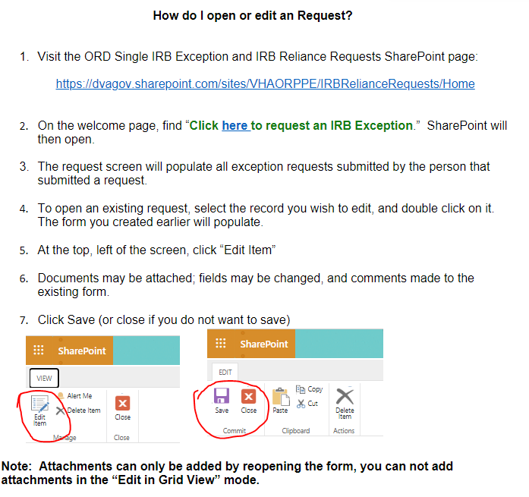

Slide 16
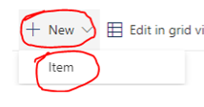
New SharePoint Application Process
Notes:
Click on “New” then on “Item,” and the application will open up.

Slide 17
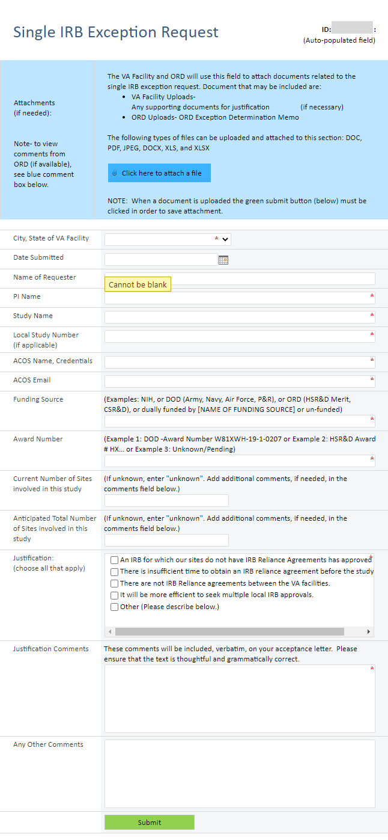

Slide 18
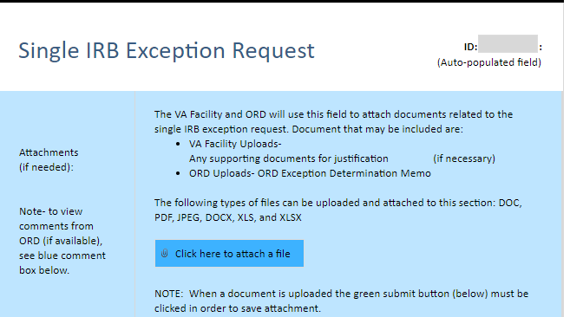
Form to Complete in SharePoint

Slide 19
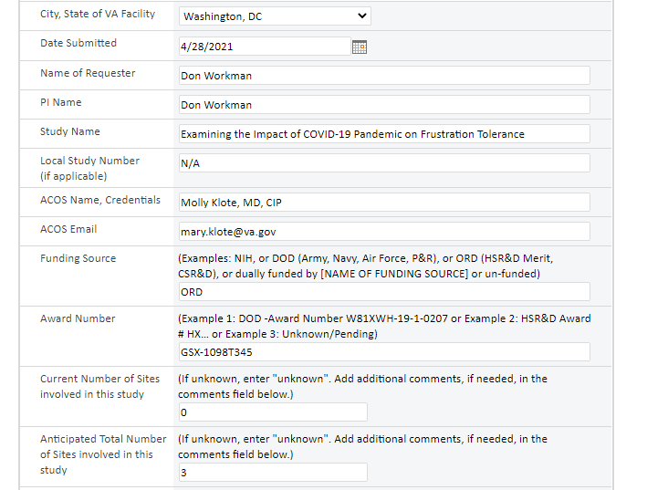

Slide 20
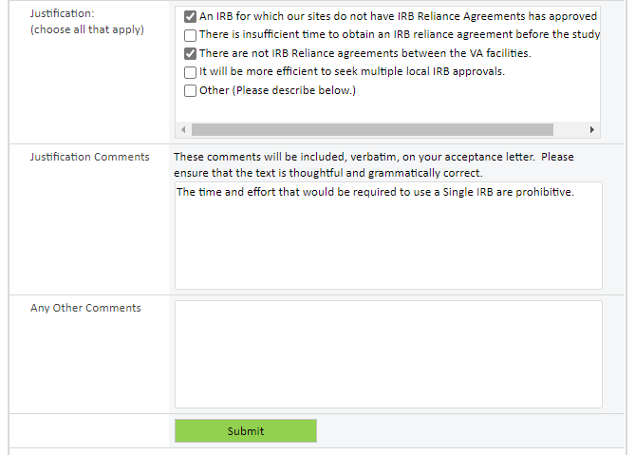
This content will be in the determination letter.
Don’t forget to press “Submit”!

Slide 21
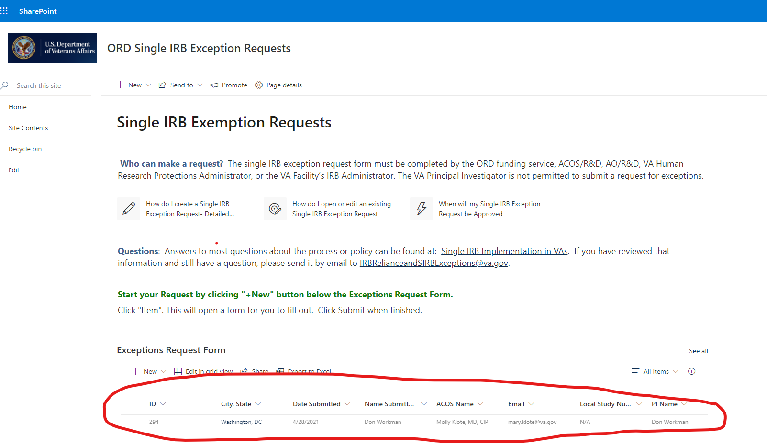
What Will Appear After Pressing Submit After Creation of the SharePoint Item?

Slide 22
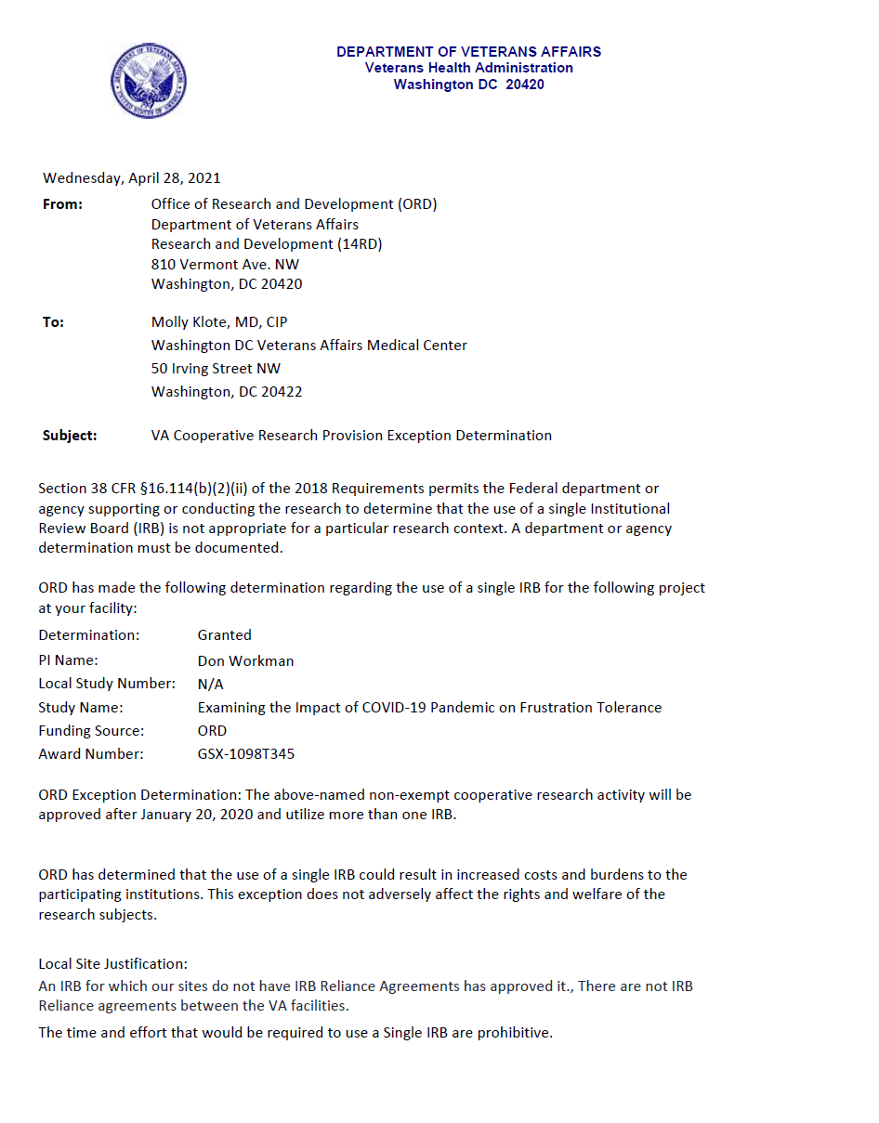
Sample of Letter:
ORD Approval of Exception from Cooperative Research Provisions

Slide 23
Availability of Recording
A recording of this session and the associated handouts will be available on ORPP&E’s Education and Training website approximately one-week post-webinar
An archive of this and other webinars can be found here: https://www.research.va.gov/programs/orppe/education/webinars/archives.cfm

Slide 24

QUESTIONS?

